Slide 1
Take Note
Creating change together
Wrap-Up Huddle: [Partner Project Name]

Slide 2
Wrap-Up Huddle
Case Studies

Slide 3
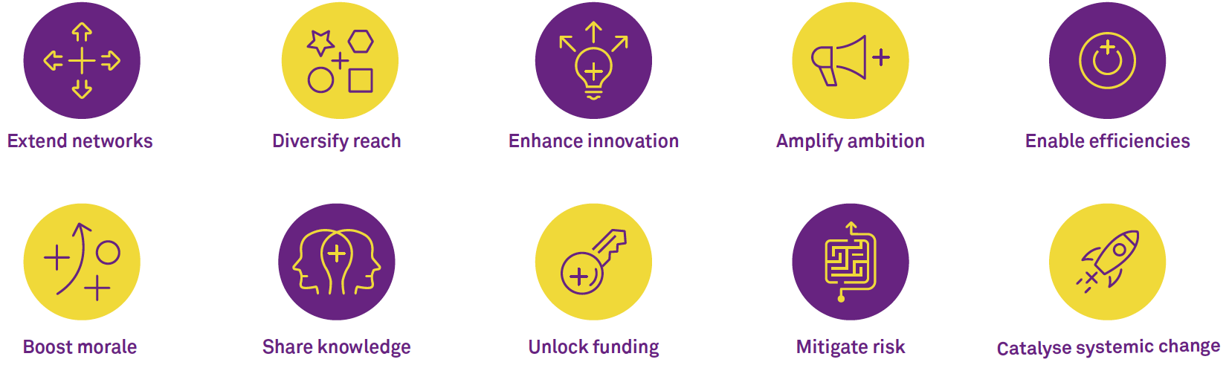
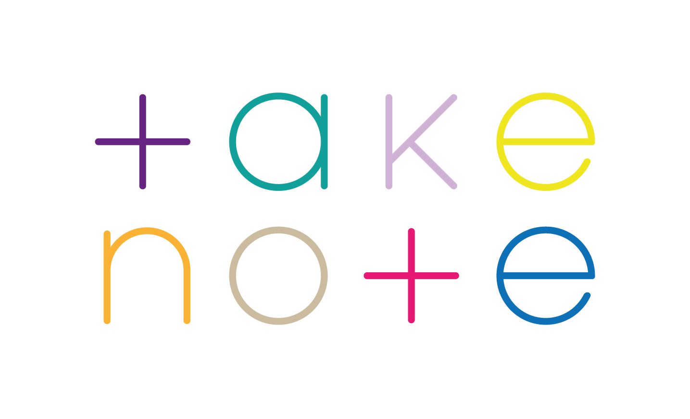
Impact of collaboration

Slide 4
Impact of collaboration
1. Share knowledge Partners came from a range of backgrounds and brought with them specific areas of expertise; the project helped partners to access this new expertise and understand where there were particular limitations or opportunities.
2. Boost morale For an artform struggling with its identity, the project helped practitioners to bring the artform to new communities and new audiences, as well as opening up opportunities for those previously unfamiliar with it to explore the practice and potentially become future practitioners / educators.
3. Diversity reach Partners felt the collaboration exposed their communities to new skills, practices and ways of working - particularly of benefit for those already experiencing the negative effects of cultural isolation.
Note: the above sections were filled in by the facilitator based on notes made during the presentation: they are presented as blank during the session.

Slide 5
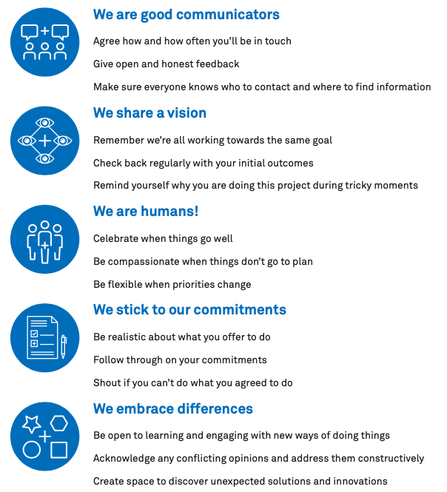
Strengths and weaknesses

Slide 6
Strengths and weaknesses
Partnership strengths Initial discussion of ideas and challenges Regular and open communication through WhatsApp created a forum for constructive feedback and honest sharing of ideas and fears Openness to new ways of working | Partnership weaknesses Initial challenges to find the focus of the project and balance artistic and social outcomes (however the discussions to find compromise would be of eventual benefit to the overall project) Limited time and capacity at the very start of the project to feed into the initial application phase
Strategies to take forward Discuss the balance between allowing space for a creative collaboration to develop organically and managing expectations among the group | Future mitigations Create more space before the project begins to explore intended outcomes for each partner
Note: the above sections were filled in by the facilitator based on notes made during the presentation: they are presented as blank during the session.

Slide 7
What makes a successful partnership?
Clarify the ‘why’
Partners articulate the shared vision for the project and what they want it collectively to achieve. They consider how this feeds into each partner’s wider organisational objectives.
Take time to set it up
Partners create space at the beginning of the project to build strong foundations for the partnership, including plotting out each partner’s roles and responsibilities and addressing from the start any potentially challenging power dynamics.
Give the partnership as much love as the project
Partners spend time talking about how they want to approach their work together and what they consider to be their shared values. They create space to keep checking in on the health of the partnership throughout the project.

Slide 8
Wrap-up Huddle
What next?
Sustaining the project’s outcomes
Sharing the learning to continue to highlight the artform more broadly and this collaboration specifically, through future film screenings, using the filmed material more widely and presenting on the project publicly Build on the learning of the collaboration by continuing to focus on mental health projects led and shaped by people with lived experience Strengthen the partnerships established in the project, including through future face-to-face activity Apply the learning outside of this collaboration, in particular by protecting the mental health of those involved in delivering complex artistic projects
Note: the above sections were filled in by the facilitator based on notes made during the presentation: they are presented as blank during the session.
Take a look at the What Next? tool for reference
→ page 60 of the Collaboration Guidebook

